Slide 1
Sound starts after calling up the next two slides

Slide 2
05-31-18 NEW DISCOVERIES fhf18L 34 / 487
Intro, Introduce speakers
DHamer
Corrosion Alert
Poland Parade - Destroy.
BP Ale
5-rotor Enigma
A465 with diagram-Yacht
Ammerland Enigma
Paul’s red numbered rotors
Swedish Sub: Ulven M-209
Polish WW-II Museum
Recognizing Polish Contributions
Autopsies and Details of Relics
Restoration of Relics – Or Not
Never before seen Enigma-in-Action Photos
Bombes
The Trojan Horse Enigmas

Slide 3
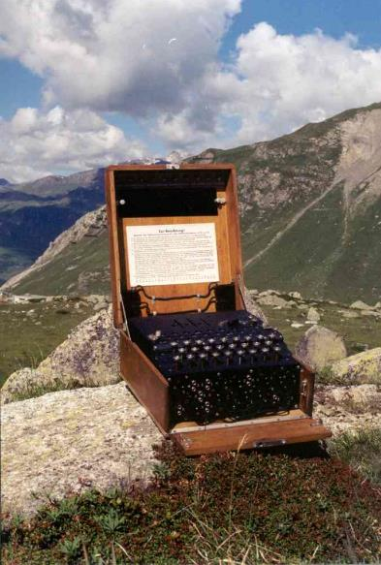
Sixth Annual Enigma Forum
The ENIGMA and other Historic Cipher Machines
HamRadio 2018
Tom Perera W1TP
New ENIGMA Discoveries
Paul Reuvers PE1BXL and
Marc Simons PE1RRT
Enigma History
Klaus Schmeh
Hidden in Plain Sight: Steganography
Paul Reuvers PE1BXL and
Marc Simons PE1RRT
Hidden Microphones: Bugs
Klaus Kopacz DC8HL
Exact Enigma Replica
ENIGMA Tables in the Flea Market:
Halle A3 Tables G49 - G55

Slide 4
Sixth Annual Enigma Forum
The ENIGMA and other Historic Cipher Machines
HamRadio 2018
Tom Perera W1TP
New ENIGMA Discoveries
Klaus Schmeh
Hidden in Plain Sight: Steganography
John Alexander
Enigma Codebook
Klaus Schmeh
Cryptology
Klaus Kopacz DC8HL
Exact Enigma Replica
ENIGMA Tables in the Flea Market:
Halle A3 Tables G49 - G55

Slide 5
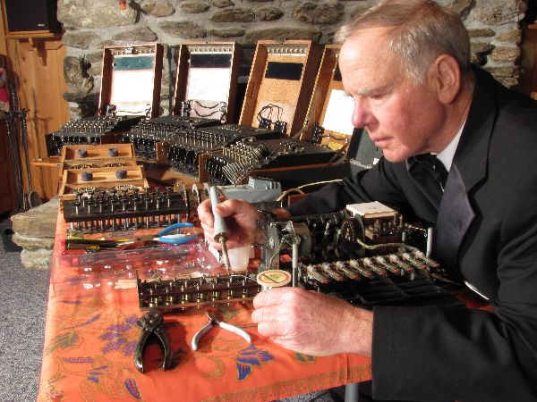
Tom Perera - Introduction

Slide 6
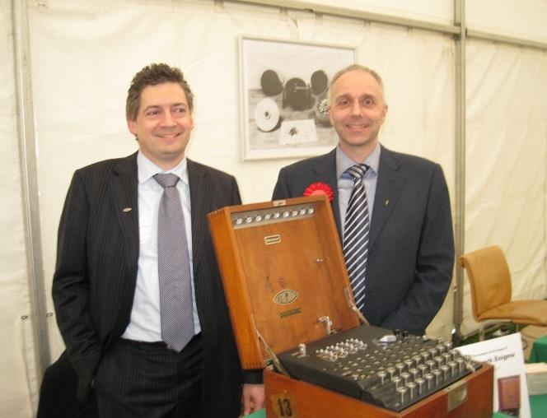
www.cryptomuseum.com
Marc Simons Paul Reuvers
ENIGMA
History

Slide 7
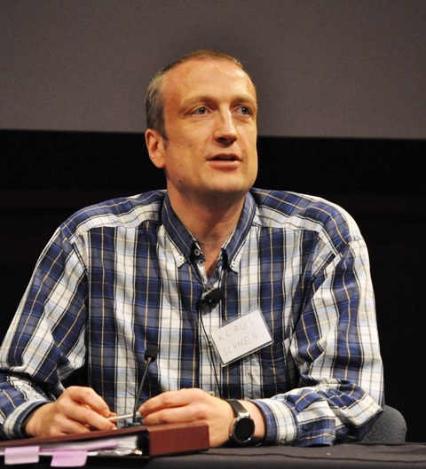
Klaus
Schmeh
Hidden
in
Plain
Sight
Steganography

Slide 8
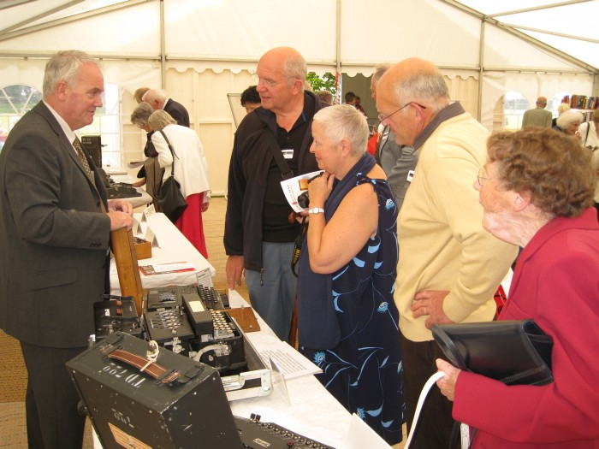
John Alexander

Slide 9
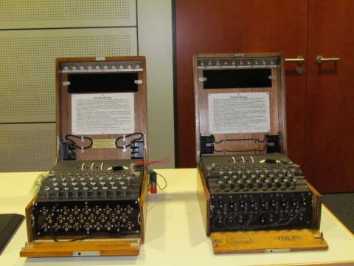
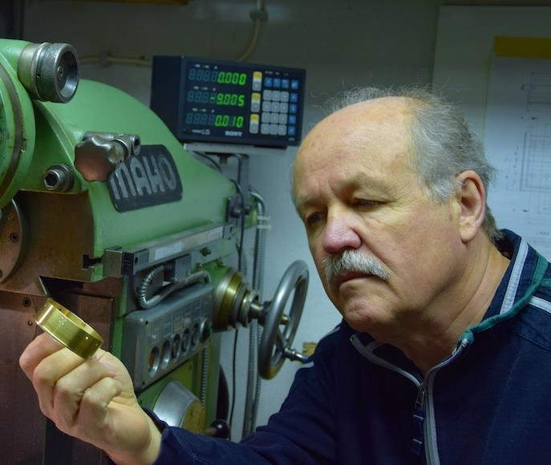
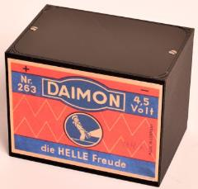
Klaus Kopacz
Exact Enigma Replica
and Enigma Battery Replica

Slide 10
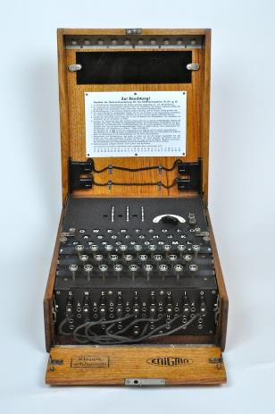
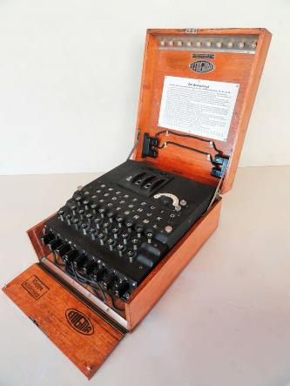
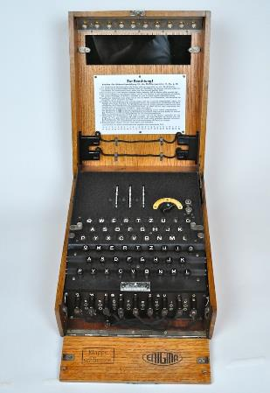
ENIGMA
Recent Discoveries
Prof. Tom Perera – W1TP and Dan Perera
www.EnigmaMuseum.com
Copyright © 2018

Slide 11
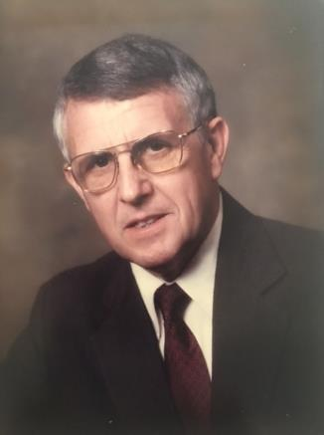
Dr. David Hamer 1934 - 2017
BATTERY
BOX
HERE
Major Contributions
2. Publications
Cryptologia (Editorial Board)
Eye Spy
Website: www.inteligenia.org
Lectures and Demonstrations
-> List of all known Enigmas
3. Leadership Roles
and Memberships in
Many Organizations
Bletchley Park
Nationaol Cryptologic Museum
American Cryptogram Assoc.
Naval Cryptologic Veterans
LIGHT PANEL
KEYBOARD
PLUGBOARD

Slide 12
Dr. David Hamer 1934 - 2017
David Hamer’s List of Surviving Enigmas
-> -> -> UPDATED in 2018 <- <- <-
http://EnigmaMuseum.com/dhlist.xls
LIGHT PANEL
KEYBOARD
280 3-rotor Military Enigmas
30 3-rotor Commercial Enigmas
77 4-rotor Navy Enigmas
13 3-rotor Tirpitz Enigmas
PLUGBOARD

Slide 13
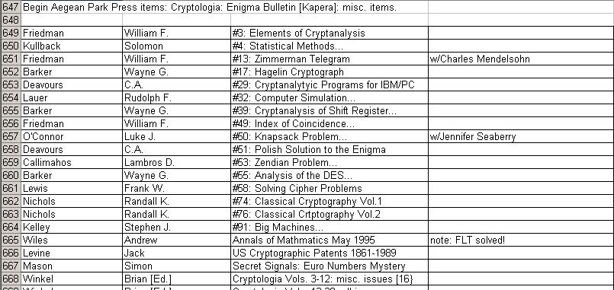
Dr. David Hamer 1934 - 2017
BATTERY
BOX
HERE
List of Books in David Hamer’s Library
http://EnigmaMuseum.com/dhbooks.xls
LIGHT PANEL
KEYBOARD
PLUGBOARD

Slide 14
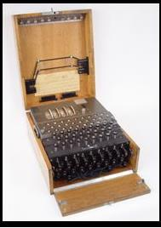
Dr. David Hamer 1934 - 2017
BATTERY
BOX
HERE
David Hamer’s
M4
4-Rotor
Enigma
LIGHT PANEL
KEYBOARD
PLUGBOARD

Slide 15
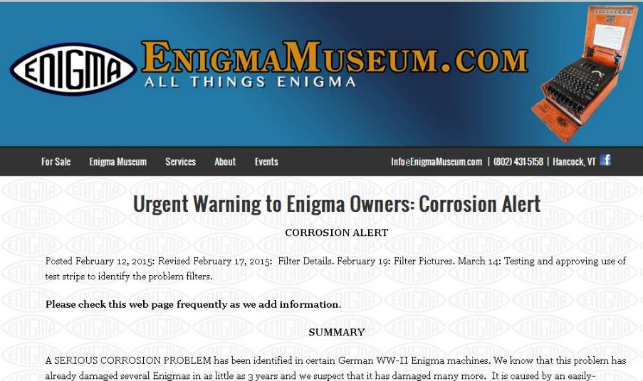
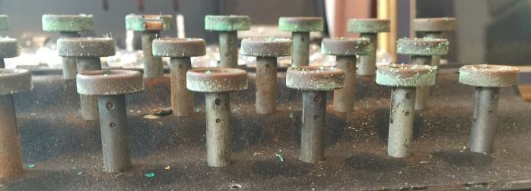

Slide 16
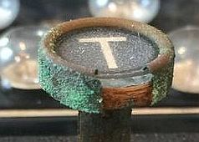

Slide 17
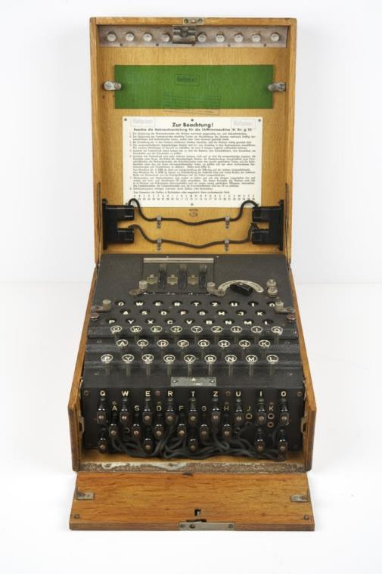

Slide 18
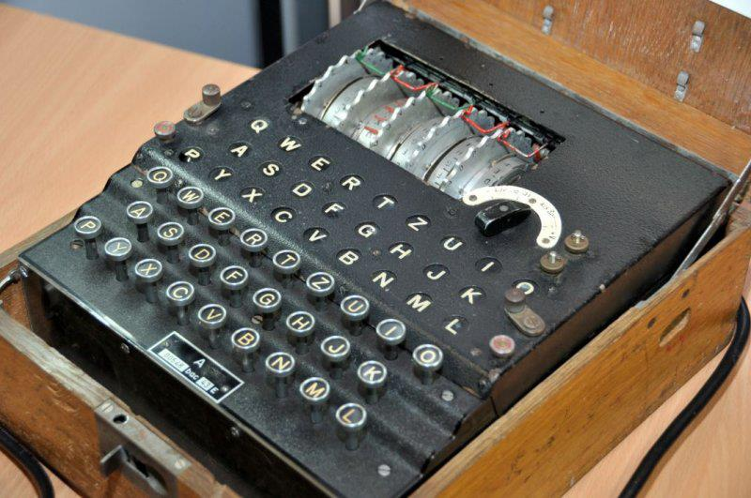
5-Rotor Enigma s/n A00528/bac/43E

Slide 19
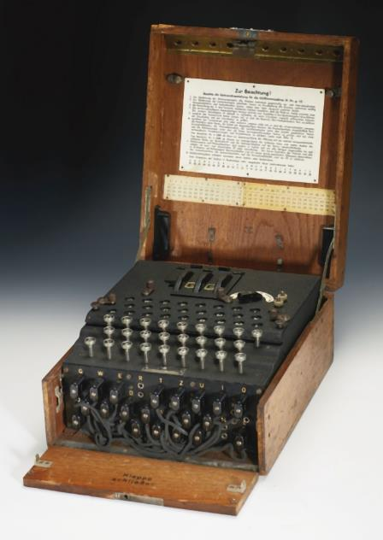
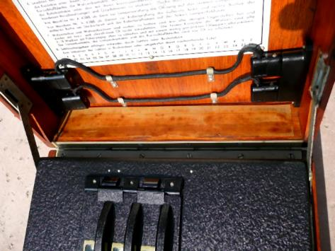
A12760
Collector Ralph Simpson
Norwegian Wiring
A15115
Owner unknown

Slide 20
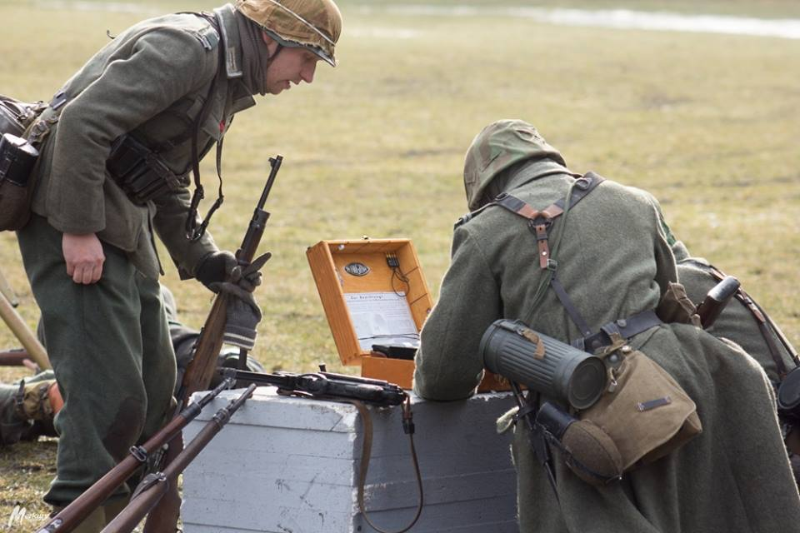
POLISH Reenactors - 2018

Slide 21
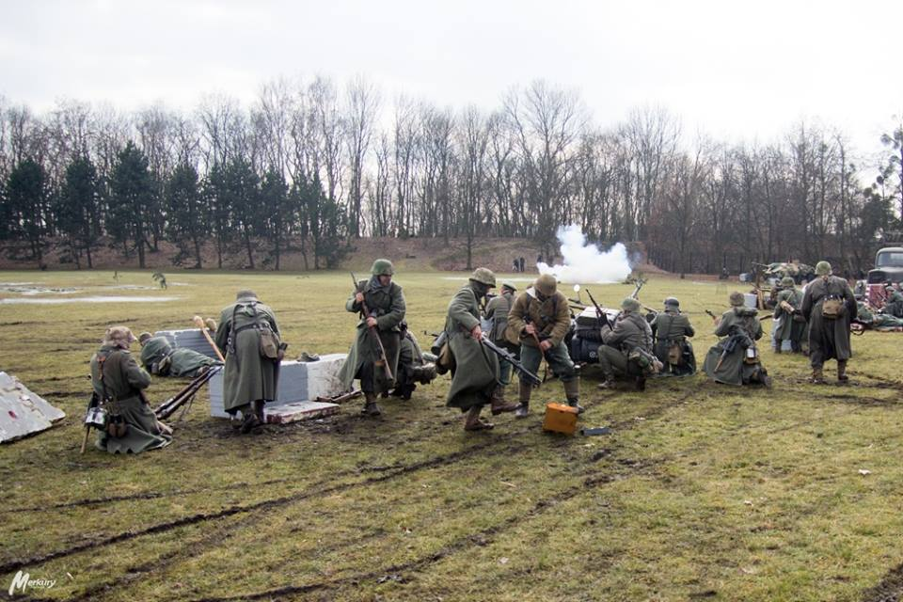
POLISH Reenactors - 2018

Slide 22
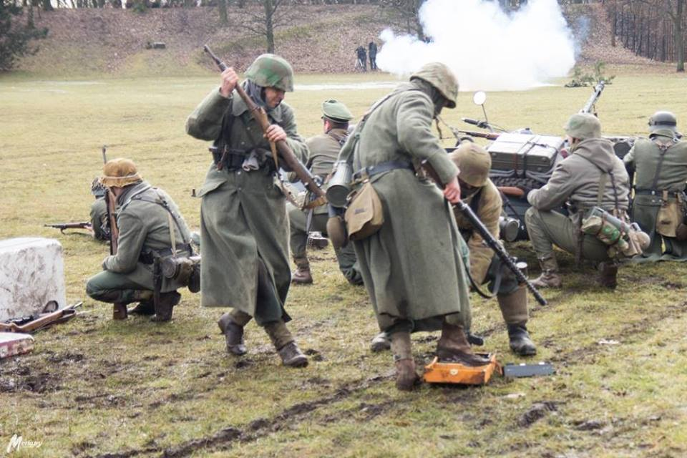

Slide 23
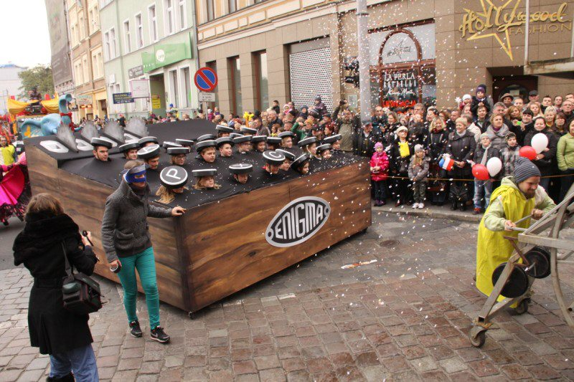

Slide 24
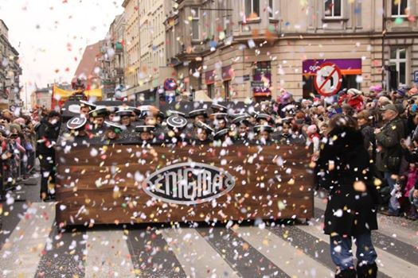

Slide 25
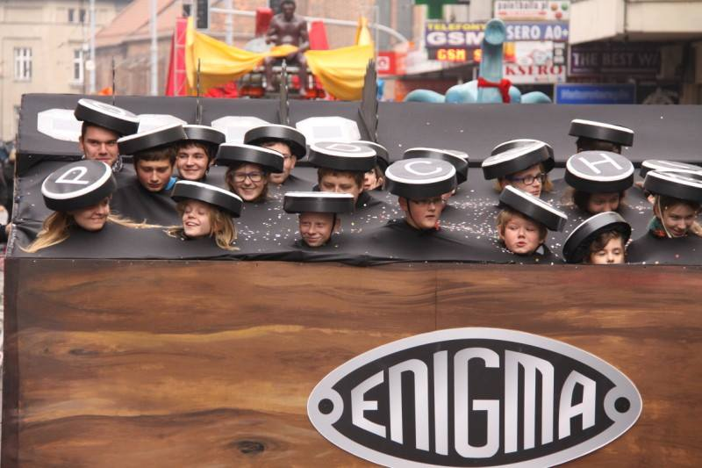

Slide 26
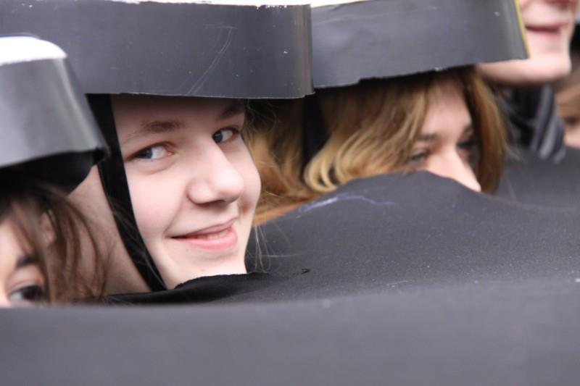

Slide 27
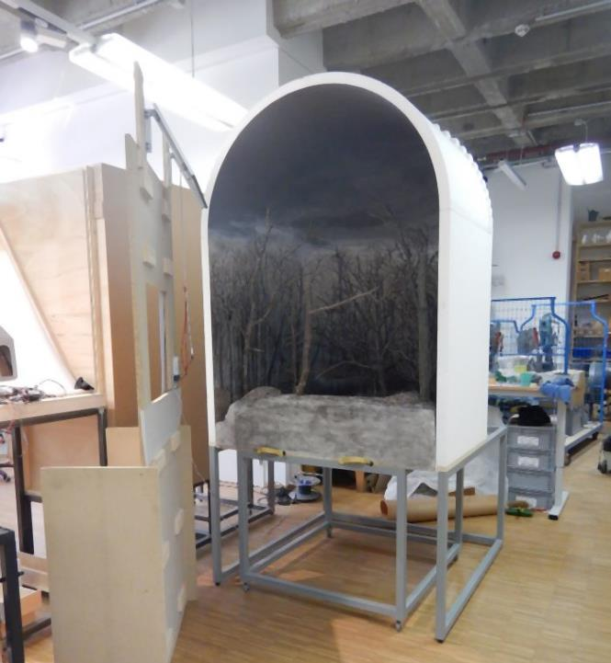
DEUTSCHES
MUSEUM
Munich
May 28, 2018

Slide 28
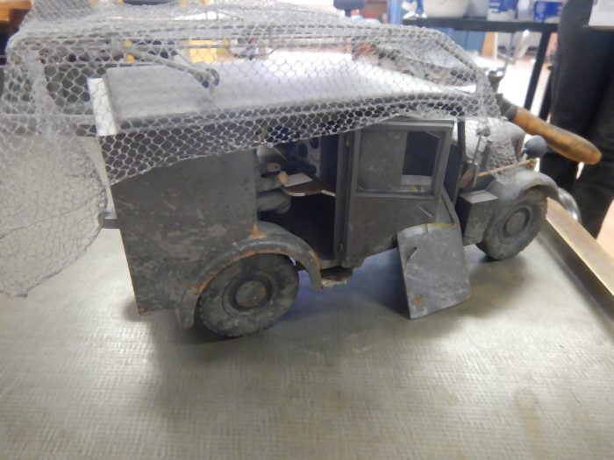

Slide 29
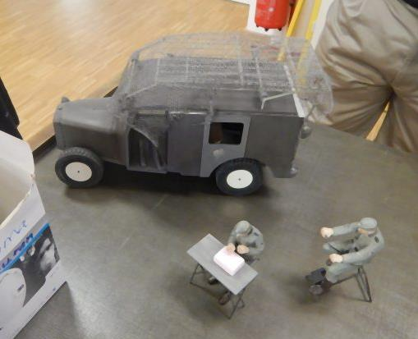

Slide 30
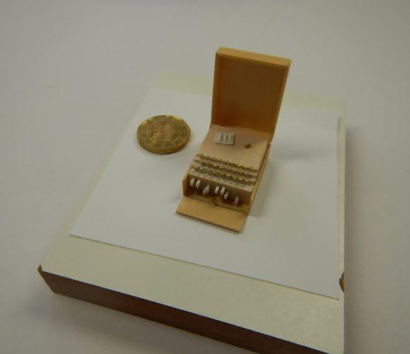

Slide 31
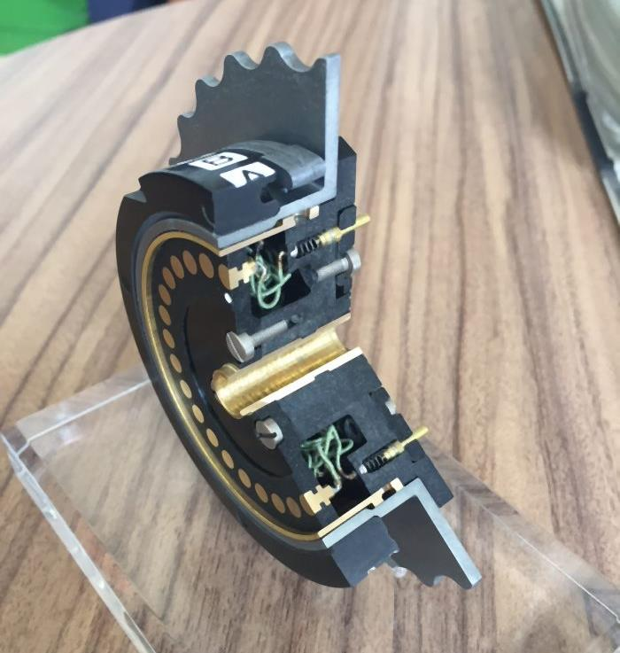

Slide 32
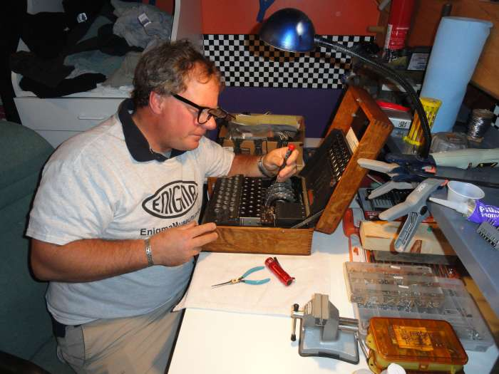
Dan
Perera
EnigmaMuseum.com

Slide 33
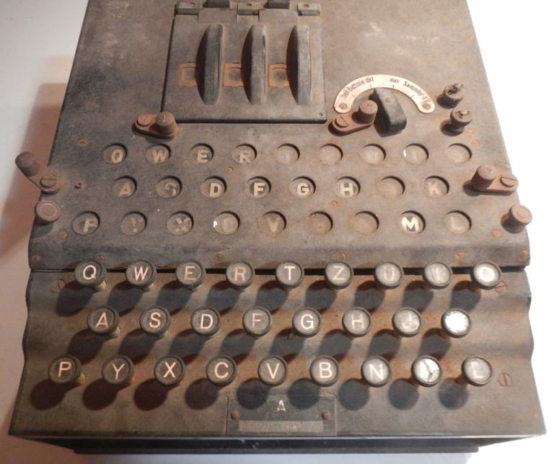

Slide 34
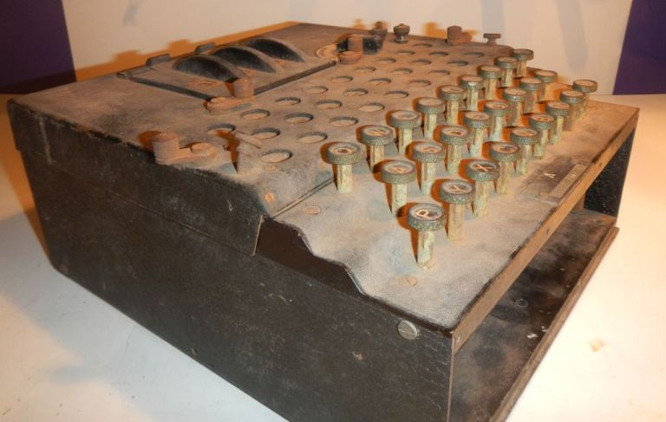

Slide 35
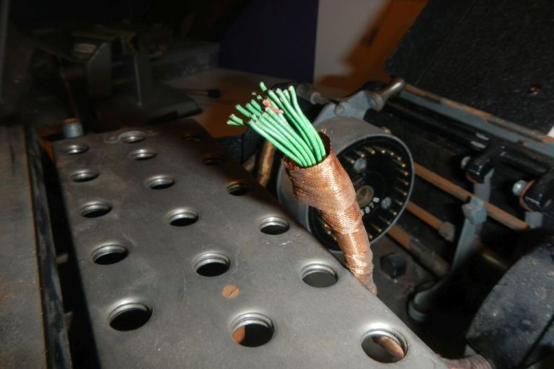

Slide 36
©Tom Perera, W1TP – Dan Perera, 2018 © Presentation Management Dokumentationsarchiv Funk www.dokufunk.org office@dokufunk.org Tonaufzeichnung und Post production: Christoph Hubner

